Slide 1
OIT Procurement Process Improvement Project
Presented By:
Logan Kearney, Linden Beck, Gunavardhan, Peter Hunter

Slide 2
Problem
The OIT Procurement department currently does not have a method to determine stock levels or predict re-stock points. This leads to stockouts and increases ticket resolution times.

Slide 3
OIT Overview
Office of Information Technology
U of I’s IT department
Centralized ticketing system (TDX)
Procurement Department
Processes procurement tickets
Maintains inventory
Orders equipment for everyone at the university
TSP’s (Technology Solution Partners)
Customer facing
Notes:
TSP – Staff and faculty

Slide 4
Project Challenges
Changing scope
Messy data
ProModel crashes
Notes:
Changing scope – Analyze data predict when to reorder, Added stock sites between TSP’s and Procurement (more effective?)
Messy Data – Logan will touch on more - finding out what was useful and what was not (over 3000 tickets)
Promodel crashes – running 1400+ lines of arrivals

Slide 5
Project Scope
Create a predictive model for re-stocking, and optimizing inventory levels
Analyze ticket data and provide data visualization
Objective: to reduce ticket resolution time and operational costs
Focus: Optimum stock levels at procurement

Slide 6
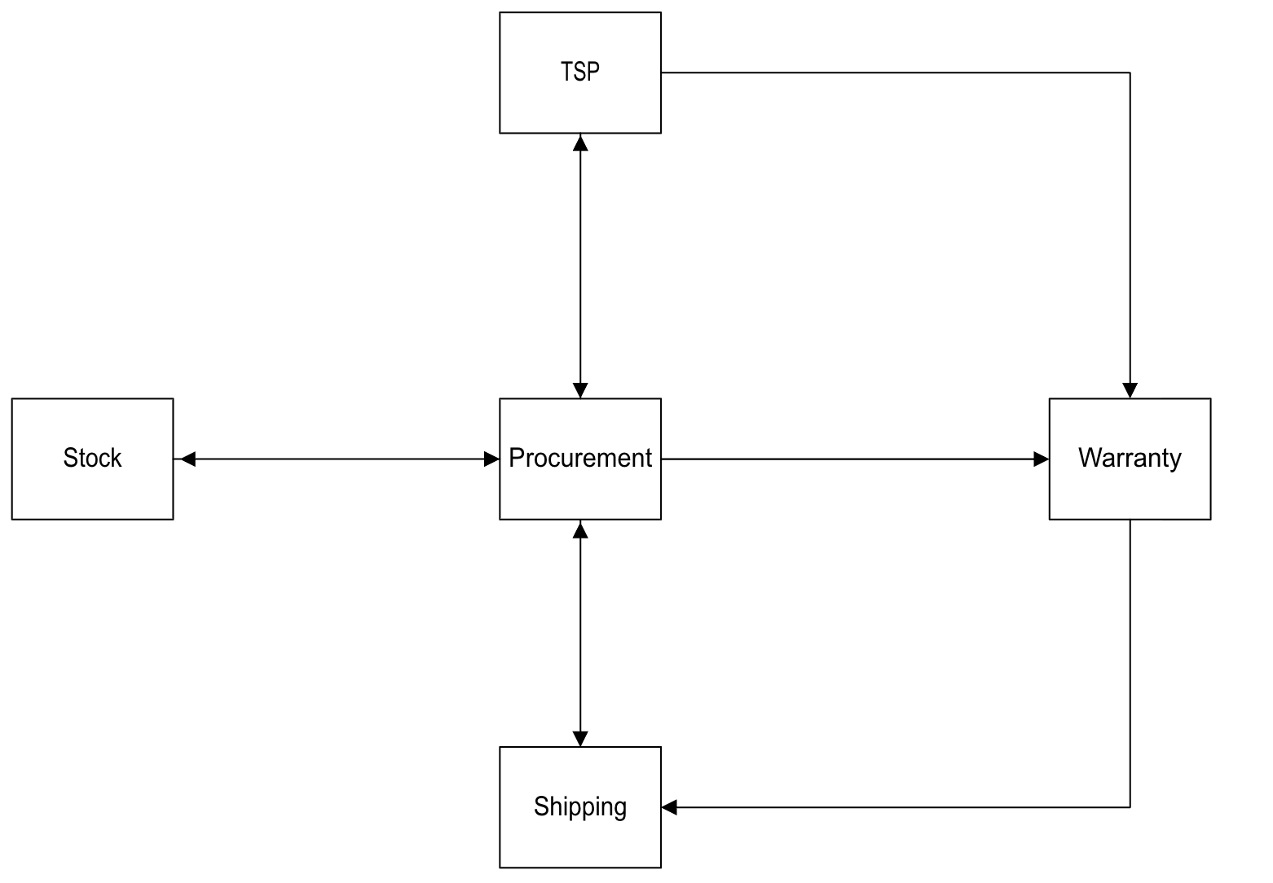
Current OIT process flow

Slide 7
Our Model
Test different ways of holding stock
No stock, order on demand
Hold large amounts of stock
How much stock should we hold?

Slide 8
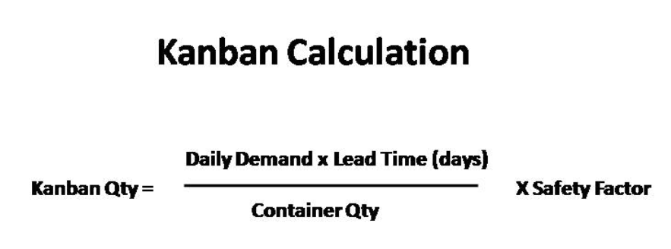
Kanban Method
Replenish only as needed
JIT methodology
Help determine how much and when to re-order
It would be ideal to have an inventory of 0 (not realistic)

Slide 9
Why this matters
Overstocking ties up budget and storage space
Understocking causes stockouts and long ticket times
Finding an optimal stock levels prevents bottlenecks in OIT’s workflow
Systemic improvements support expansion and growth

Slide 10
Current Process Weakness
Inconsistent stock levels
Unknown re-order points
Longer ticket fulfillment times
Limited flexibility for TSP’s and procurement
Inconsistent ticket time estimation

Slide 11
Our theory and hypothesis
Kanban methodology = reduced lead times
Low-cost, high-frequency items are ideal for stocking
Potential overall time savings through reduced stockouts

Slide 12
Data Analysis

Slide 13
Data Analysis Section Overview
Section Overview
Why talk about data?
Data Acquisition
Ticket Data
Data Types
Data Processing
VOD’s
Python filtering
Processed Data
Outputs
About the process
Improvements
Layout Changes
Data Type Changes

Slide 14
Why talk data?
Informs decision making
Tracks progress and milestones
Compare alternative methods
Auditing
Demand prediction

Slide 15
Ticket Data
What do we have here?

Slide 16
Ticket Data – Project Perspective
Pros
Cons
Plenty of data ~3400 Tickets
Differentiated data fields
2 Fiscal years of data
Real world data is messy
Incomplete/blank fields
Inaccurate records
Missing fields

Slide 17
Raw Ticket Data
Ticket ID
Asset Count
Primary Responsibility
Description
Age
Created By
Acct/Dept
Service Category
Source
Tags
Total Cost of Order
Vendor Order Description
Invoice Number
Vendor
Location

Slide 18
Data Types
How is it used?

Slide 19
Data Types
User Data
Input by a user or employee
Ranges in values, usually text based
Catalogue Data
Pulls from a drop-down or catalogue
Includes Tags
User specified from a set list
Generated Data
Users Input data to create fields
May generate as a byproduct of a workflow step
Metric Data
Generated by the ticketing system automatically

Slide 20
Ticket Data w/Data Types
Ticket ID [M]
Asset Count [G]
Primary Responsibility [C]
Description [U]
Age [M]
Created By [M]
Acct/Dept [C]
Service Category [M]
Source [M]
Tags [C]
Total Cost of Order [U]
VOD[C]
Invoice Number [C]
Vendor [C]
Location [C]

Slide 21
Why Data Types Matter
Data Accuracy
Mature data types are controlled
Less potential variance
Automation
Mature data types are machine readable
Accounting/Auditing
Better control over input
Automatic checking of data for errors

Slide 22
Ticket #254618
Average Case Study

Slide 23
Data in #254618
Ticket ID
#254618
Responsibility
Description
Age
147 Days
Created By
Acct/Dept
677 - CNR
Source
Service Catalog
Tags
N/A
Total Cost
$2,246.52
Vender Order Description (VOD)
Vendor
Amazon, IT Stock, Lenovo
Location
055 COLLEGE OF NATURAL RESOURCES (CNR)

Slide 24
VODs
Vendor Order Descriptions
Notes:
Jump into data formatting, time to talk VODs
How did we get this data for analysis?

Slide 25
What is a VOD?
Does Contain
Does not contain
Description of items to purchase
Includes order Quantity, Item, and unit Price
VODs can contain multiple lines of QIP
Ticket info
Process info
Source and Routing info
Notes:
What it is
What it does
Why does it exist

Slide 26
Example VOD - Ticket #254618
QTY 1- ThinkPad X1 Nano G2, Intel® Core™ i7-1260P (E-cores up to 3.40GHz, ) 13 2160 x 1350 Touch, Windows 11 Pro 64, 16.0GB, 1x512GB SSD M.2 2242 PCIe Gen4 TLC Opal, Intel® Iris® Xe Graphics, BT 5.2,Wi-Fi 6E AX211, 1080P FHD IR, 3 Cell Li-Pol 49.5Wh, 4YR Onsite,Accidental Damage Protection at $1,699
QTY 1- Lenovo ThinkPad Universal Thunderbolt 4 Dock at $260
QTY 1- SAMSUNG 980 PRO SSD 1TB PCIe 4.0 NVMe Gen 4 Gaming M.2 Internal Solid State Hard Drive Memory Card, Maximum Speed, Thermal Control, MZ-V8P1T0B at $139.99
QTY 1- Crucial - DDR4 - module - 32 GB - DIMM 288-pin - 3200 MHz / PC4-25600 - unb at $147.53

Slide 27
Why talk about VODs?
Hold significant data
Primary descriptor of order
Reflect the structure of ticket data
Effect how processes are handled
Showcase method for processing information
Python + Manual filtering
Notes:
In context of this project

Slide 28
VOD Processing Steps
Section Identification
Separation
Trimming
Categorization
Information Loading
Export

Slide 29
Example VOD Breakdown
QTY 1- ThinkPad X1 Nano G2, Intel® Core™ i7-1260P (E-cores up to 3.40GHz, ) 13 2160 x 1350 Touch, Windows 11 Pro 64, 16.0GB, 1x512GB SSD M.2 2242 PCIe Gen4 TLC Opal, Intel® Iris® Xe Graphics, BT 5.2,Wi-Fi 6E AX211, 1080P FHD IR, 3 Cell Li-Pol 49.5Wh, 4YR Onsite,Accidental Damage Protection at $1,699
QTY 1- Lenovo ThinkPad Universal Thunderbolt 4 Dock at $260
QTY 1- SAMSUNG 980 PRO SSD 1TB PCIe 4.0 NVMe Gen 4 Gaming M.2 Internal Solid State Hard Drive Memory Card, Maximum Speed, Thermal Control, MZ-V8P1T0B at $139.99
QTY 1- Crucial - DDR4 - module - 32 GB - DIMM 288-pin - 3200 MHz / PC4-25600 - unb at $147.53

Slide 30
Section Identification
QTY 1- ThinkPad X1 Nano G2, Intel® Core™ i7-1260P (E-cores up to 3.40GHz, ) 13 2160 x 1350 Touch, Windows 11 Pro 64, 16.0GB, 1x512GB SSD M.2 2242 PCIe Gen4 TLC Opal, Intel® Iris® Xe Graphics, BT 5.2,Wi-Fi 6E AX211, 1080P FHD IR, 3 Cell Li-Pol 49.5Wh, 4YR Onsite,Accidental Damage Protection at $1,699
QTY 1- Lenovo ThinkPad Universal Thunderbolt 4 Dock at $260
QTY 1- SAMSUNG 980 PRO SSD 1TB PCIe 4.0 NVMe Gen 4 Gaming M.2 Internal Solid State Hard Drive Memory Card, Maximum Speed, Thermal Control, MZ-V8P1T0B at $139.99
QTY 1- Crucial - DDR4 - module - 32 GB - DIMM 288-pin - 3200 MHz / PC4-25600 - unb at $147.53

Slide 31
Section Identification
QTY 1- ThinkPad X1 Nano G2, Intel® Core™ i7-1260P (E-cores up to 3.40GHz, ) 13 2160 x 1350 Touch, Windows 11 Pro 64, 16.0GB, 1x512GB SSD M.2 2242 PCIe Gen4 TLC Opal, Intel® Iris® Xe Graphics, BT 5.2,Wi-Fi 6E AX211, 1080P FHD IR, 3 Cell Li-Pol 49.5Wh, 4YR Onsite,Accidental Damage Protection at $1,699

Slide 32
Separation
Quantity: QTY 1-
Item: ThinkPad X1 Nano G2, Intel® Core™ i7-1260P (E-cores up to 3.40GHz, ) 13 2160 x 1350 Touch, Windows 11 Pro 64, 16.0GB, 1x512GB SSD M.2 2242 PCIe Gen4 TLC Opal, Intel® Iris® Xe Graphics, BT 5.2,Wi-Fi 6E AX211, 1080P FHD IR, 3 Cell Li-Pol 49.5Wh, 4YR Onsite,Accidental Damage Protection
Price: at $1,699

Slide 33
Trimming
Quantity: QTY 1-
Item: ThinkPad X1 Nano G2, Intel® Core™ i7-1260P (E-cores up to 3.40GHz, ) 13 2160 x 1350 Touch, Windows 11 Pro 64, 16.0GB, 1x512GB SSD M.2 2242 PCIe Gen4 TLC Opal, Intel® Iris® Xe Graphics, BT 5.2,Wi-Fi 6E AX211, 1080P FHD IR, 3 Cell Li-Pol 49.5Wh, 4YR Onsite,Accidental Damage Protection
Price: at $1,699

Slide 34
Trimming
Quantity: 1
Item: ThinkPad X1 Nano G2
Price: $1,699

Slide 35
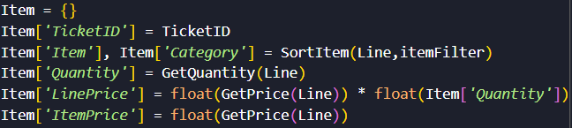
Categorization
Quantity: 1
Item: ThinkPad X1 Nano G2
Category: Laptop
Manufacturer: Lenovo
Line Price: $1,699
Item Price: $1,699

Slide 36
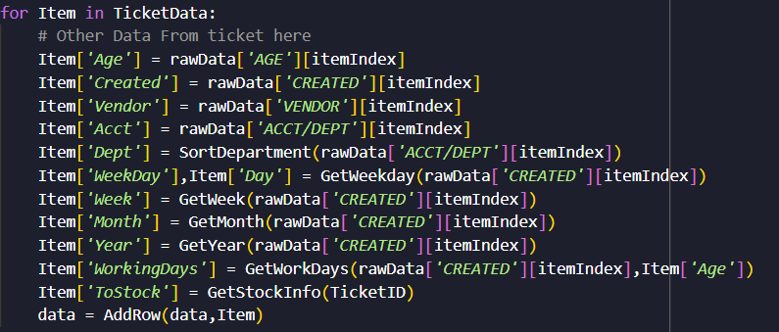
Information Loading
Quantity: 1
Item: ThinkPad X1 Nano G2
Category: Laptop
Manufacturer: Lenovo
Line Price: $1,699
Item Price: $1,699
Additional Ticket Info:

Slide 37
Export

Slide 38
Processed Data
Post-Processing and Calculated Fields

Slide 39
Filtered Data
17 Fields
Ported
Ticket IDs
Age
Calculated
Line-item Price
Category
Re-Structured
Weekdays
Department Information

Slide 40
Data Re-Structure
Line-item vs Ticket
Additional data extracted from ticket
Time series info
Department info
Additional data injected into line items
Device Category
Manufacturer
Stocking ticket IDs

Slide 41
Data Process Improvements
Ticket Re-structuring & Process Changes

Slide 42
Ticket Layout
Reduce Human Input
Move towards more mature data types
Remove excess tagging/ID systems
Separate human and machine data systems

Slide 43
Data Changes
Line-item organization for analysis
Adding additional fields for fine-grain analysis
Remove unused fields
Mature data types

Slide 44

Stock Simulation

Slide 45
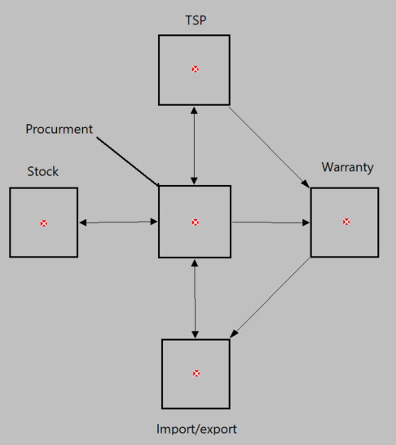
Locations
TSP
Procurement
Stock
Warranty
Import/export

Slide 46
Entities
Line_Item
Made it simpler to build into ProModel

Slide 47
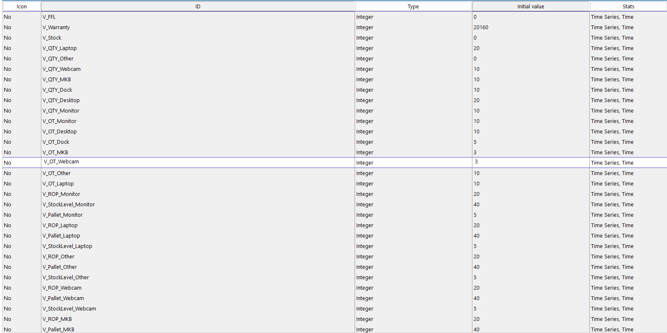
Variables
38 Variables
Notes:
The V_QTY represents the total quantity that can be held at the stock location. The V_OT represents the wait time that it takes from when you order an item to when you actually receive it.

Slide 48
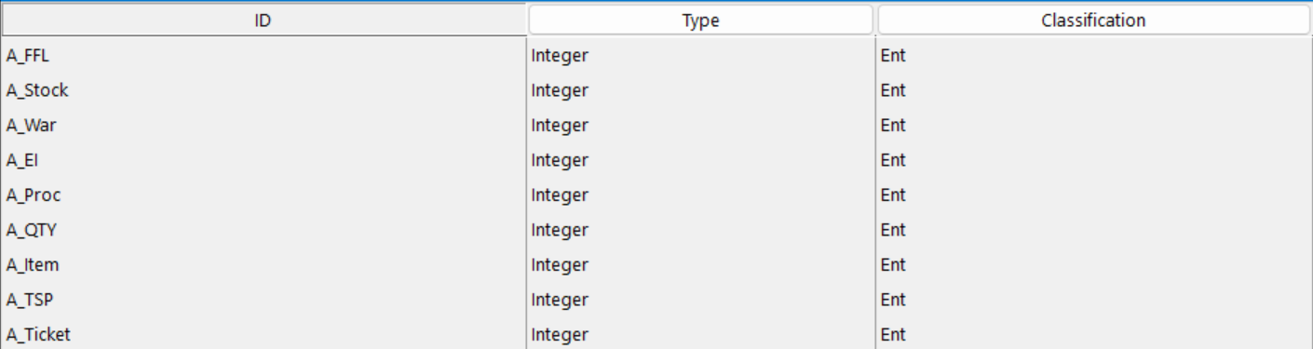
Attributes
Used attributes to sort and route orders
Notes:
We used the attributes to sort the orders based on where they needed to go. For example the A_FFL was assigned to items when they were done. This is so that they can be routed out of the system.

Slide 49
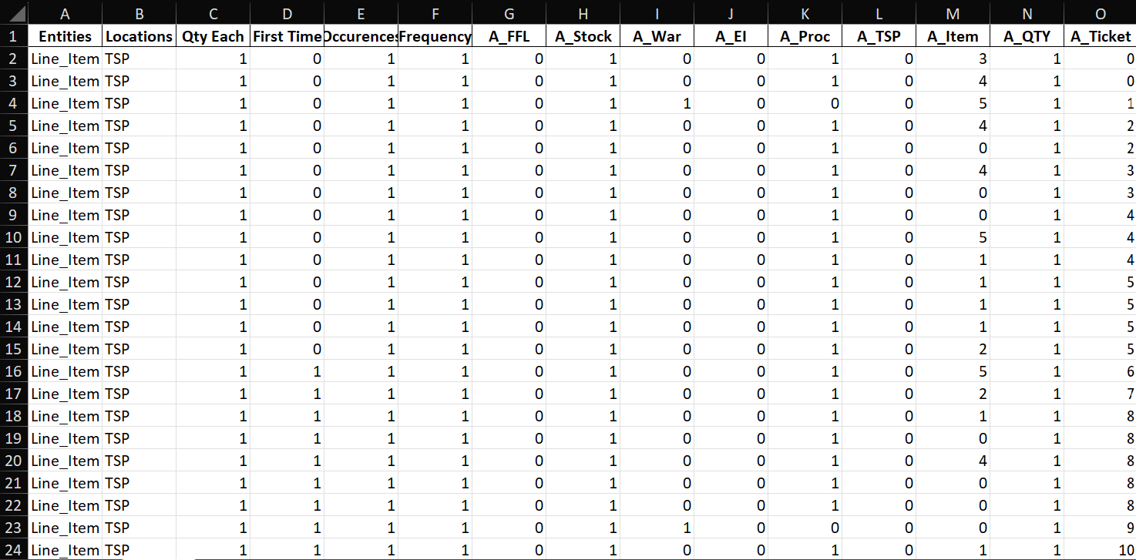
Arrivals
Notes:
In our arrivals sheet we have all of our attributes that we assigned to the orders. In the A_Item collum, this refers to the type of item such as a monitor, laptop or something else.

Slide 50
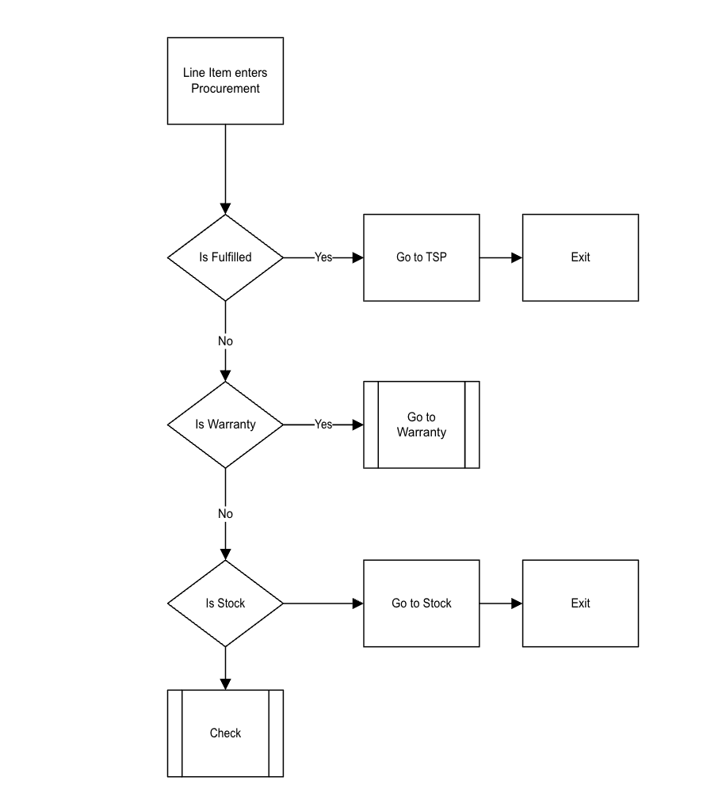
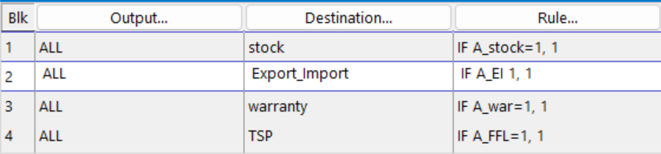
Procurement Processing
Notes:
Uses a conditional if then statement. Read as a 1 is a yes and 0 is a no.

Slide 51
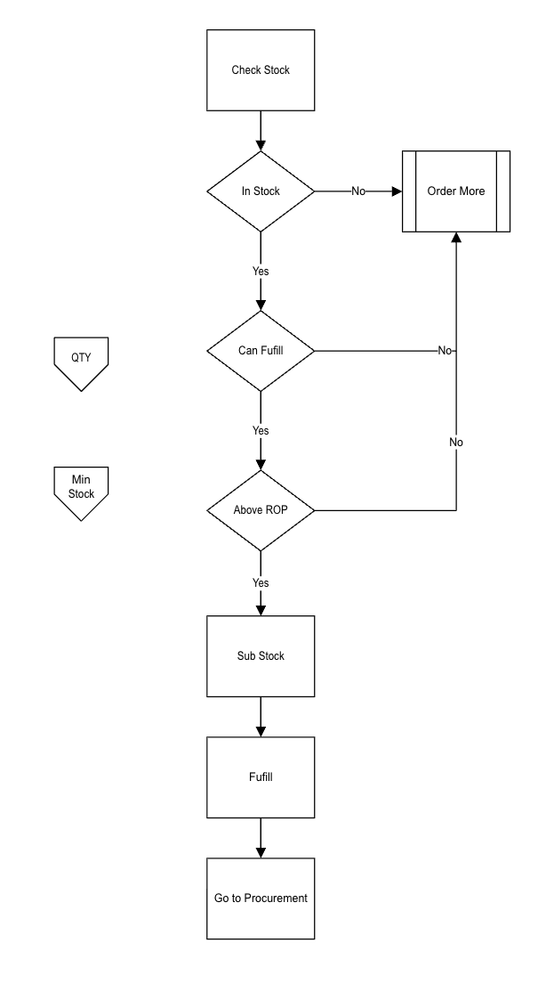
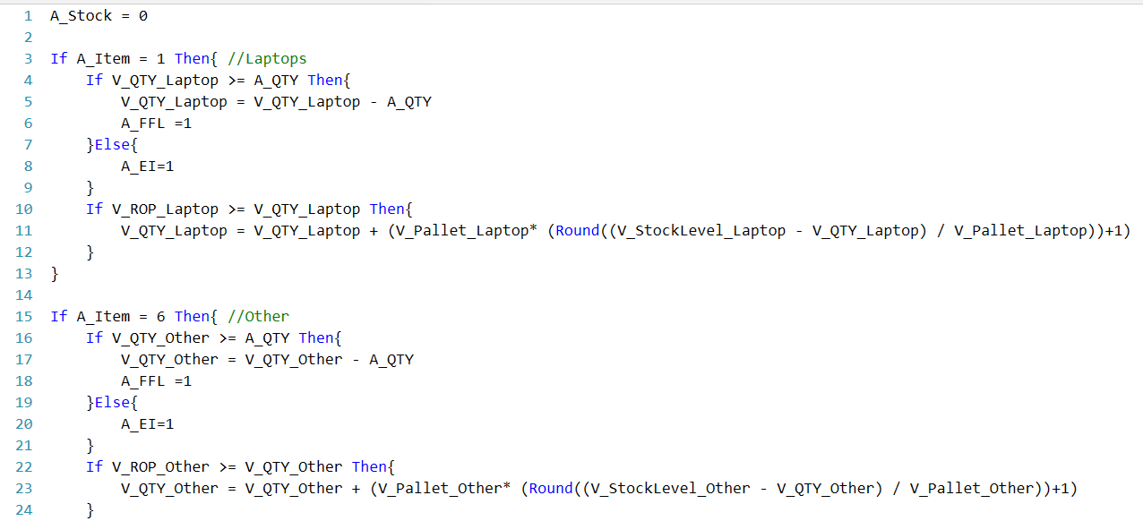
Stock Location Processing

Slide 52
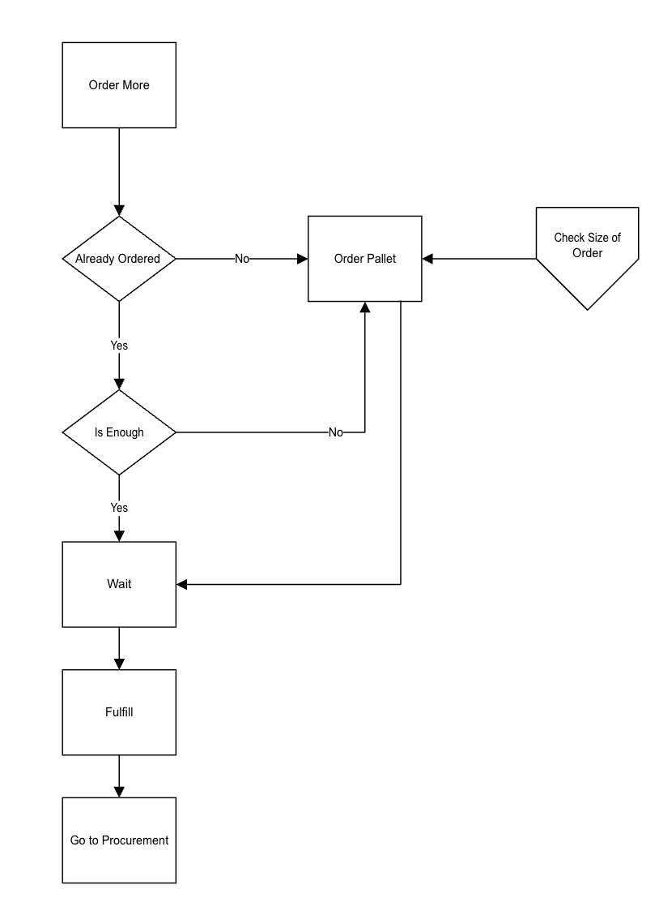
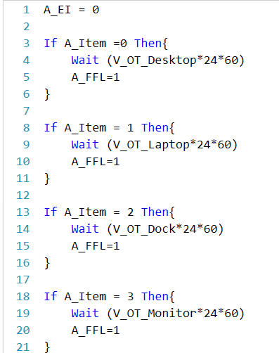
Import/Export processing
Notes:
Has orders come in. if it is a new item it gets ordered and waits. If the item is already ordered then it waits there until the items arrive

Slide 53
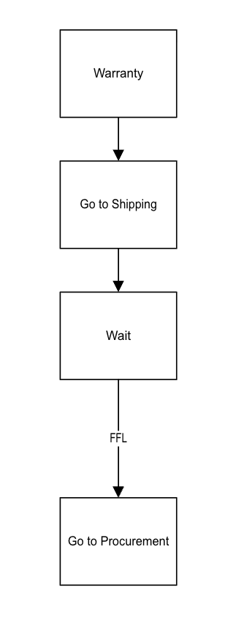

Warranty Processing

Slide 54
Findings
OIT operates on a LIFO system
Increased inventory levels led to less time in system
53% more efficient
Safety stock
Higher upfront cost
Better customer service
Notes:
Average time in system went from 36803 to 14458

Slide 55
Data Visualization
Insights through data

Slide 56
Power BI
What is Power BI ?
Power BI is a data visualization and Analytics tool that helps turn raw data into interactive insights.
Why we used it in our project?
How is it helpful ?

Slide 57
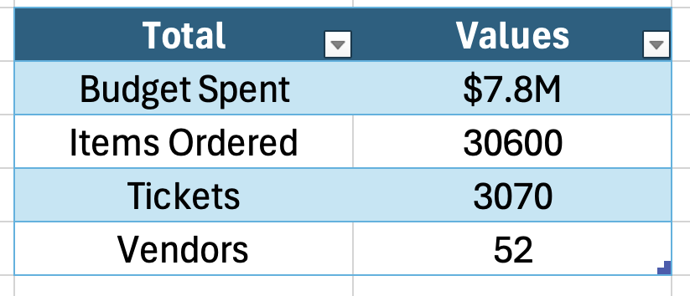
Totals From The Data
IT department spent $7.8M by purchasing 30600 in Total.
IT Orders Products from 52 Different Vendors.
IT has 3070 Tickets in two Fiscal years.

Slide 58
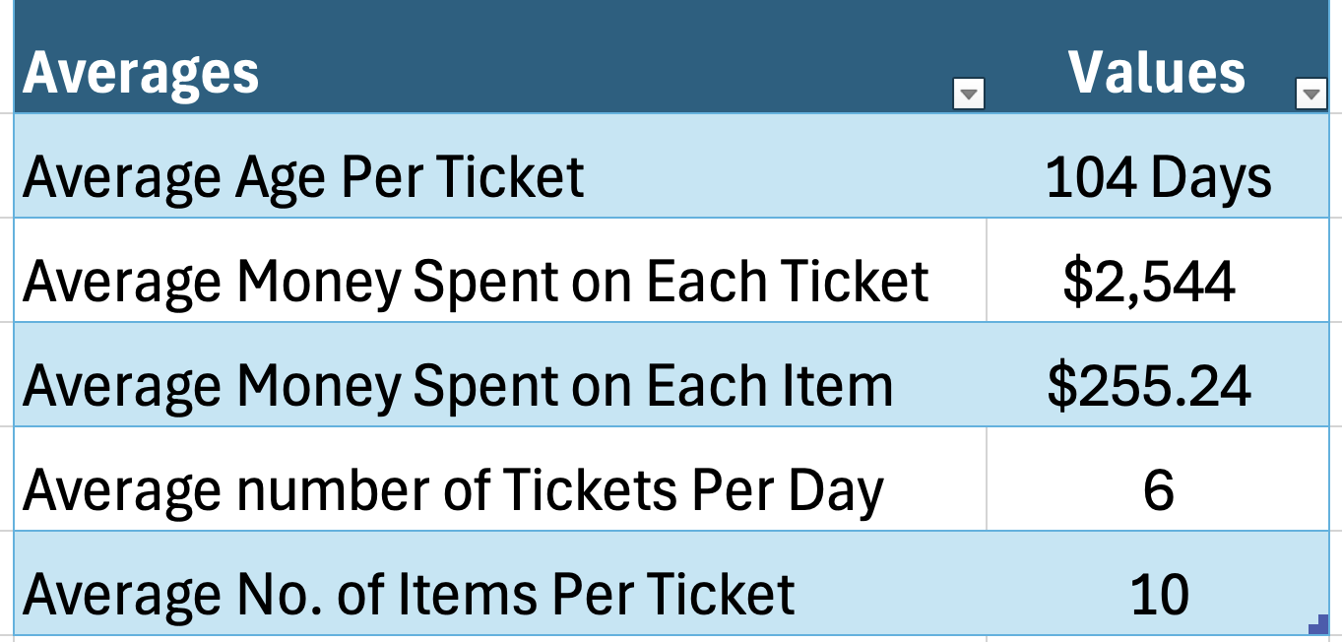
Averages From The Data
The average time it takes to complete a ticket is 104 day indicating a significant delay.
On Average, each ticket costs $2544 with $255 spent per item.
IT department processed 6 tickets per day where each ticket had 10 items on average.

Slide 59
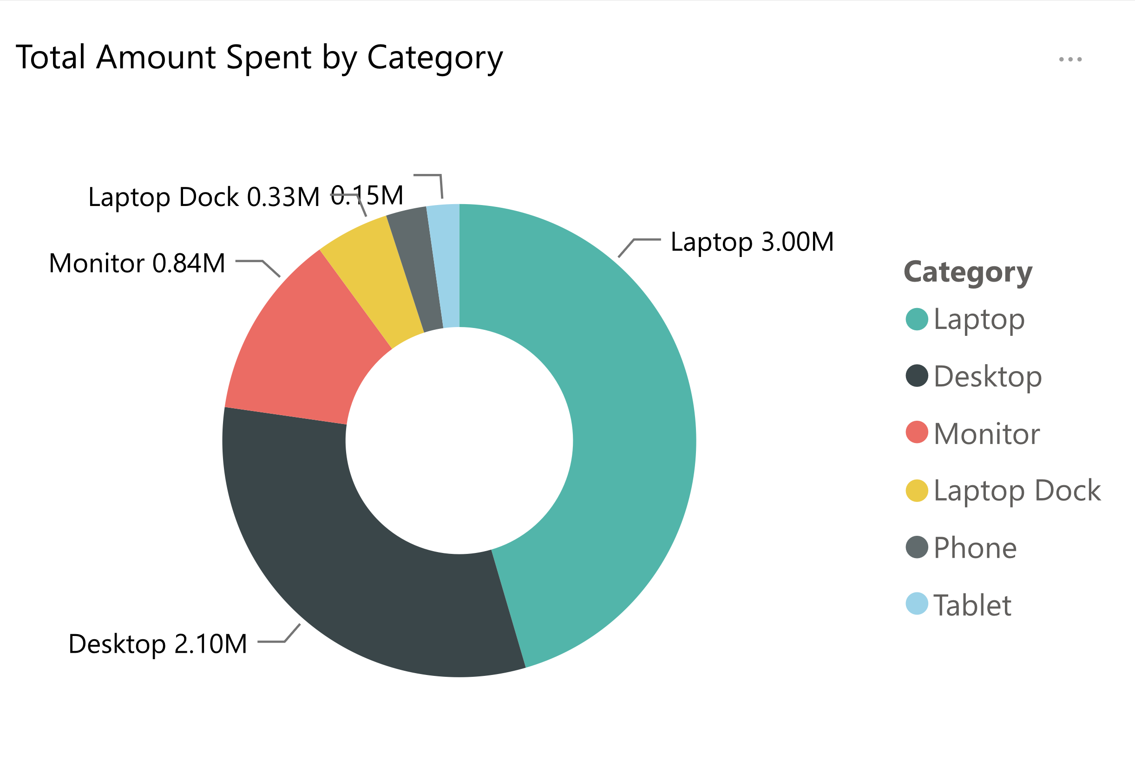
Total Dollars Spent By Category
Price vs category && Amountvsmonth
Out of the total spending, 6 million dollars was allocated to Laptops, Desktops and Monitors where remaining all other IT-related accessories costed only 1.8 Million Dollars.
Notes:
Total Amount Spent by Category
No alt text provided

Slide 60
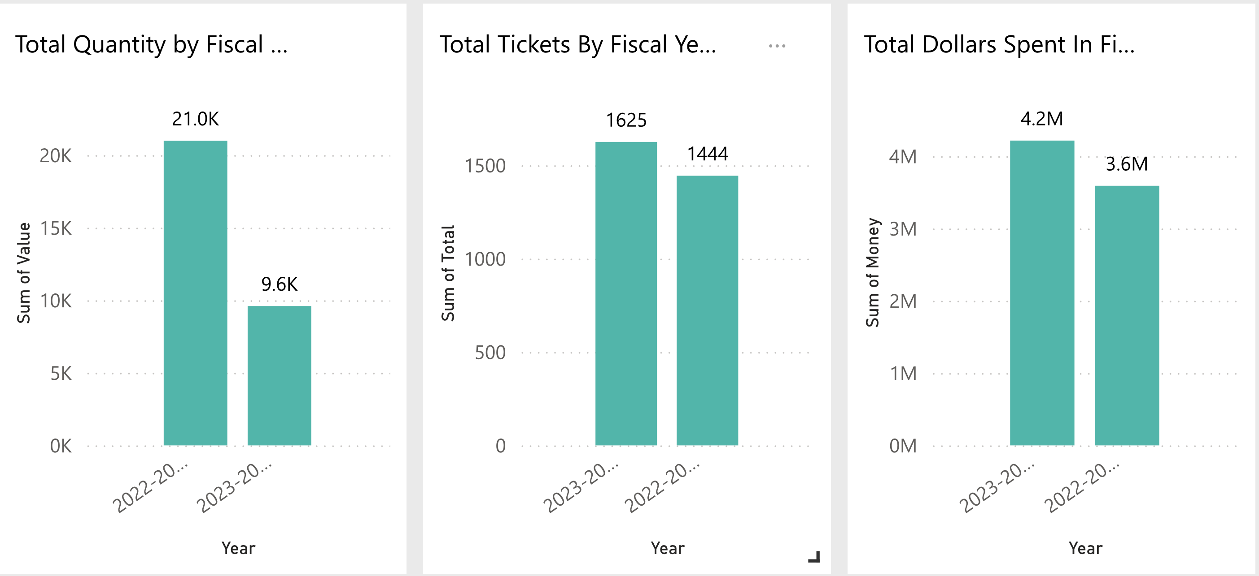
Yearly Overview
Quantity dropped Significantly from 21K units to 9.6K units.
Despite the Quantity decreased by 54%, spending only decreased by 14%.

Slide 61
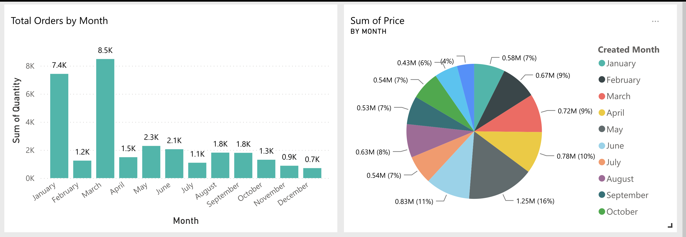
Monthly Overview
March had the highest orders followed by January.
May accounted for highest spending indicating purchases of higher price.

Slide 62
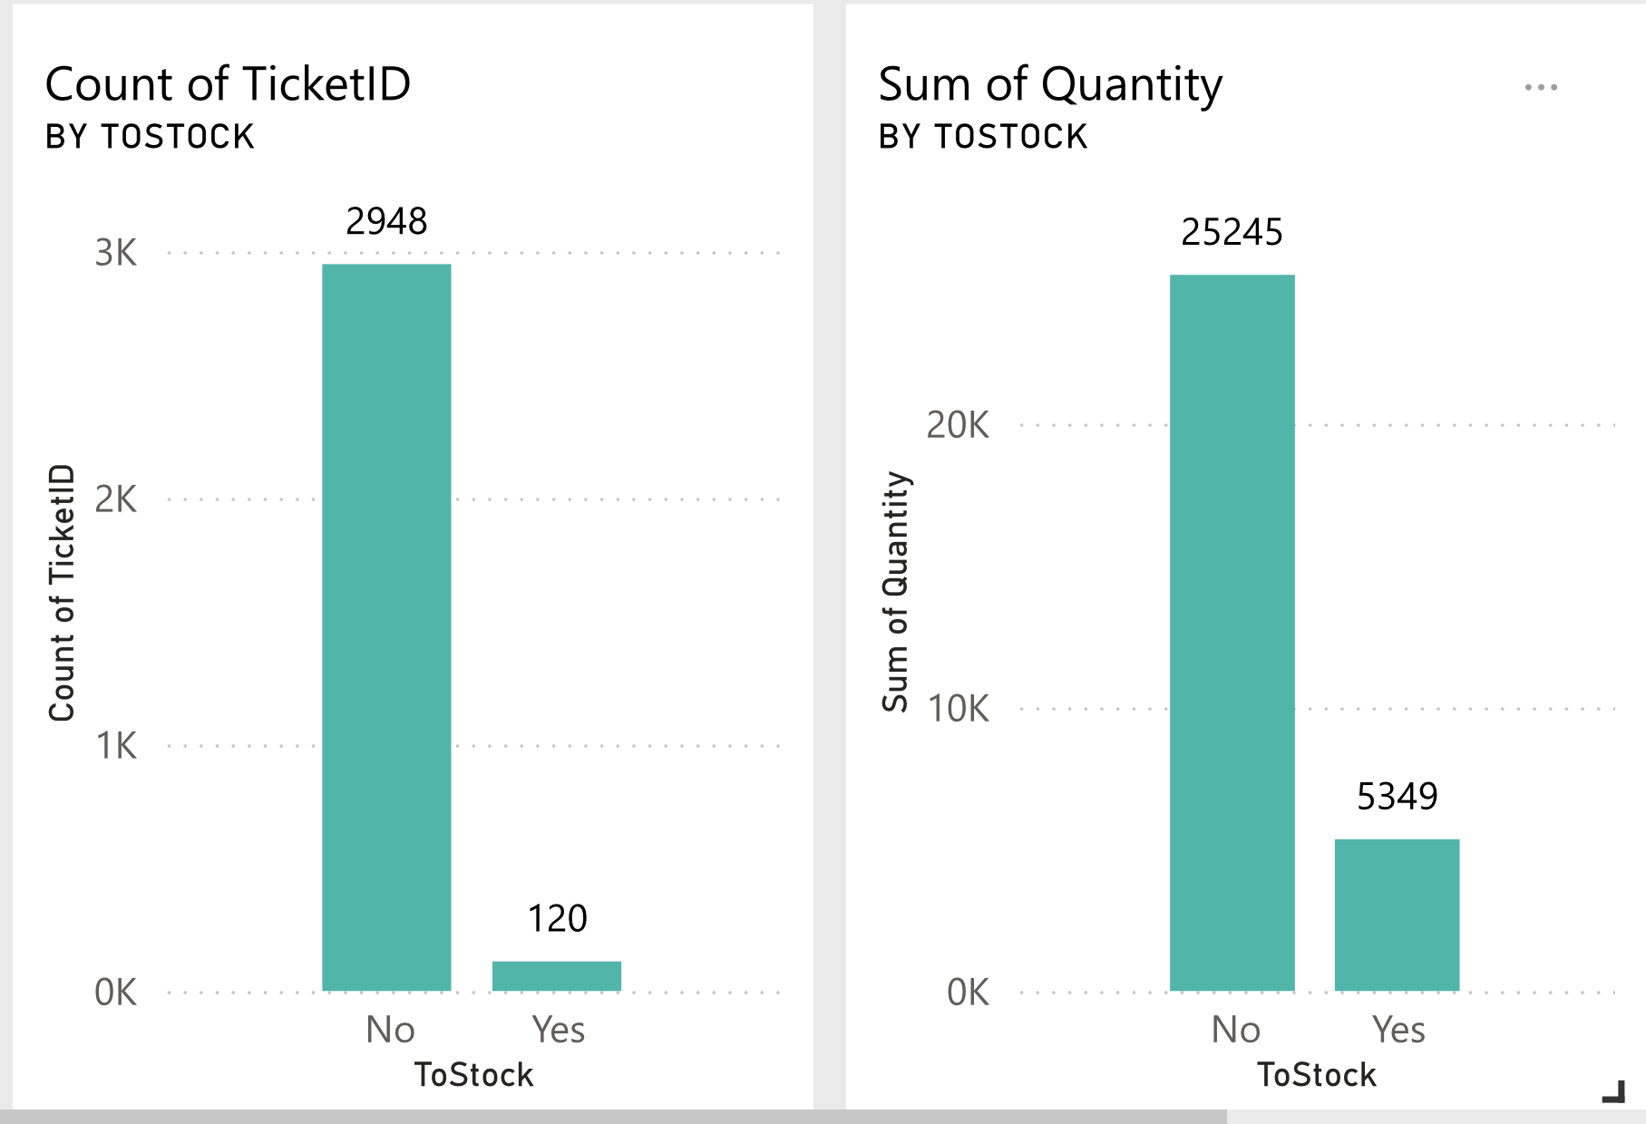
Reason for Delay
In terms of quantity only 1/5th of quantity accounts for stocking of all orders.
Despite an average of 6 tickets per day, one out of every 24 tickets is used for stocking.

